Slide 1
Follow Me Game
Instructions for teacher:
Teacher hands out a template of the game “Follow Me” (may be colorful and laminated ).
Teacher explains how to play the game: Players roll the die, take a card of the same color of the frame that they landed on. If student answers the question correctly, he/she plays again. If not, student misses a turn. First player to reach the end of the game wins. Continue playing to find out who comes in second, third, and fourth place.
Students create game question cards on a Word document in four different colors (green, yellow, red and blue), using a template provided by the teacher (see examples in slide 3). Each color represents a different question type. (Amount of cards suggested for each color is 8-10). Students fill in the cards according to the ideas below (or ideas they come up with), save their work and send it to the teacher’s email or class forum to be checked and printed.
Teacher brings the cards to class. Students play the game.
Ideas for game cards:
Cards with names of places, students mention at least one thing you can do there. E.g. Café – “You can drink coffee there. / You can meet your friend there….”
Cards with directions in English, students translate to L1.
Cards with scrambled words (locations and directions). Students unscramble the words and mention them.

Slide 2
Follow Me
Take
an
extra turn.
END
START
Take the
Short cut
Move
back
1 space.
Take the
Short cut
Move ahead
1 space.

Slide 3
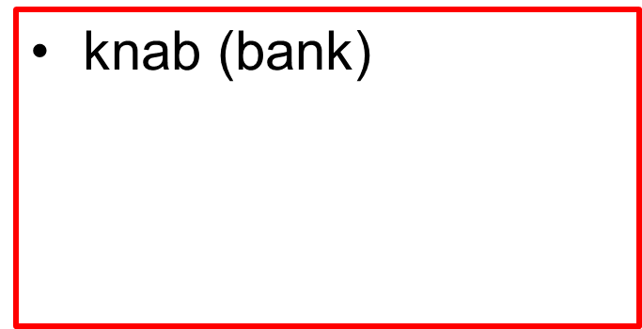
Example templates of Q cards for teachers
Here you can see a show. (theater)
Go straight!
)לך\סע ישר)
restaurant
(You can eat and drink here.)

Slide 4
Homework - Group Work
1. Choose one of the four color cards. בחרו אחד מהכרטיסים.
2. Copy it 8-10 times and fill in with your definitions. העתיקו את הכרטיס והשלימו לפי ההגדרות שלכם
3. Send to the class forum.
Here you can see a show. (theater)
Go straight!
)לך\סע ישר)
restaurant
(You can eat and drink here.)

